Slide 1
Tour and Travelling Management System
Aditi Rajbongshi
ID : CSE 063 07 385
Nazmus Sakib
ID : CSE 057 06 986
Farzana Akhter
ID : CSE 063 07 425

Slide 2
Introduction
What is Tour Management System?
01
What is the purpose of Tour Management system?
02
Who can use the system?
03

Slide 3




Motivations for this Project
Integrated Software
Helps the Tourism
Standalone Platform
Modules

Slide 4



Features
Directly Connected
Modify and Delete Data
Packages

Slide 5

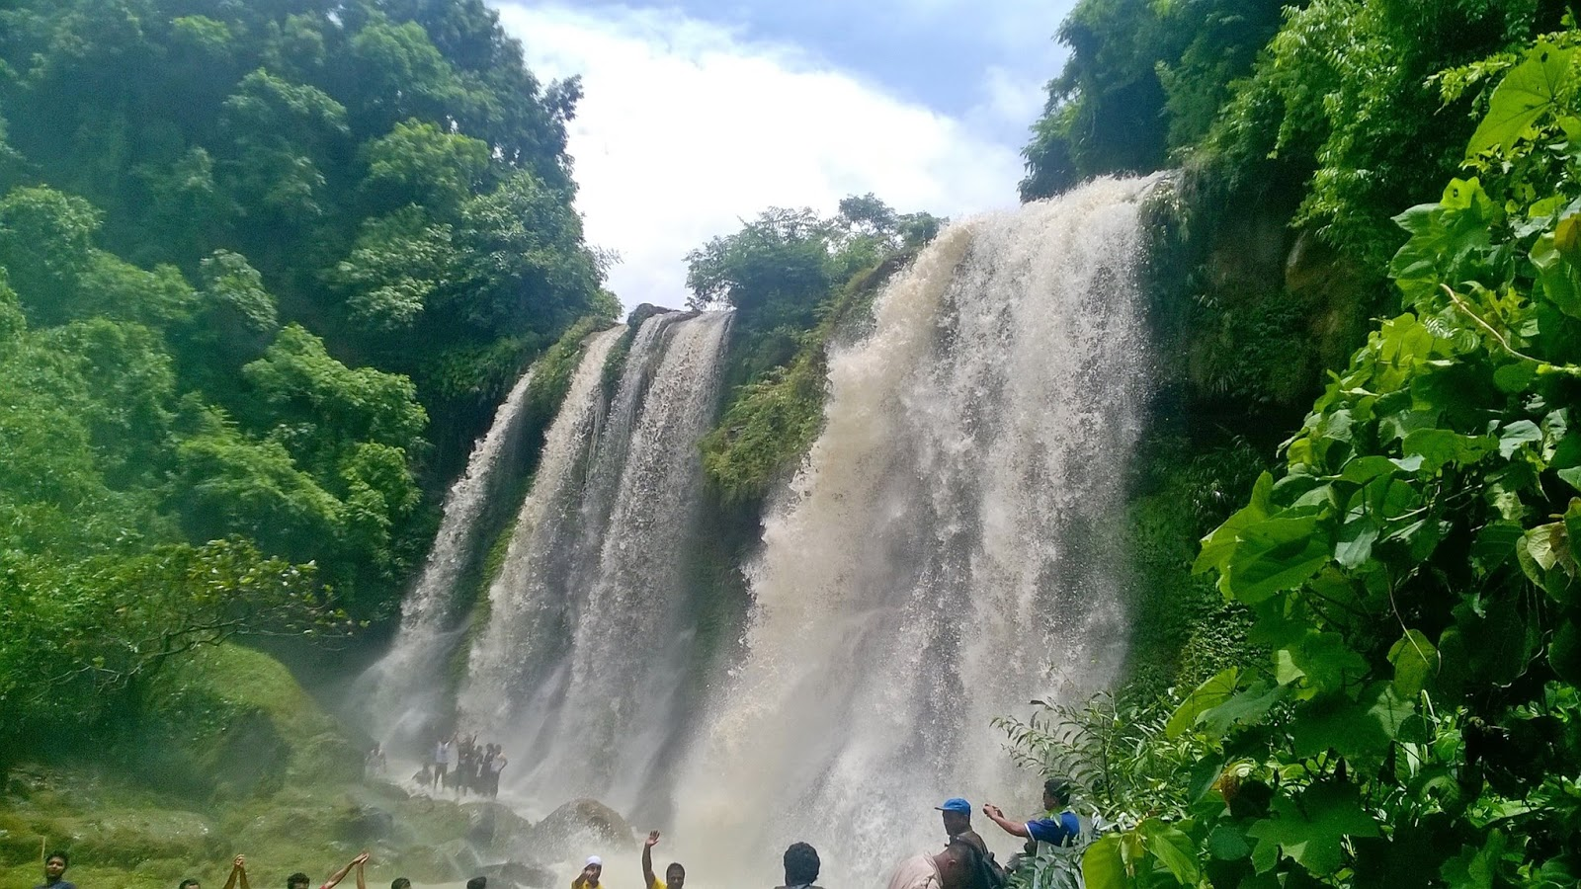

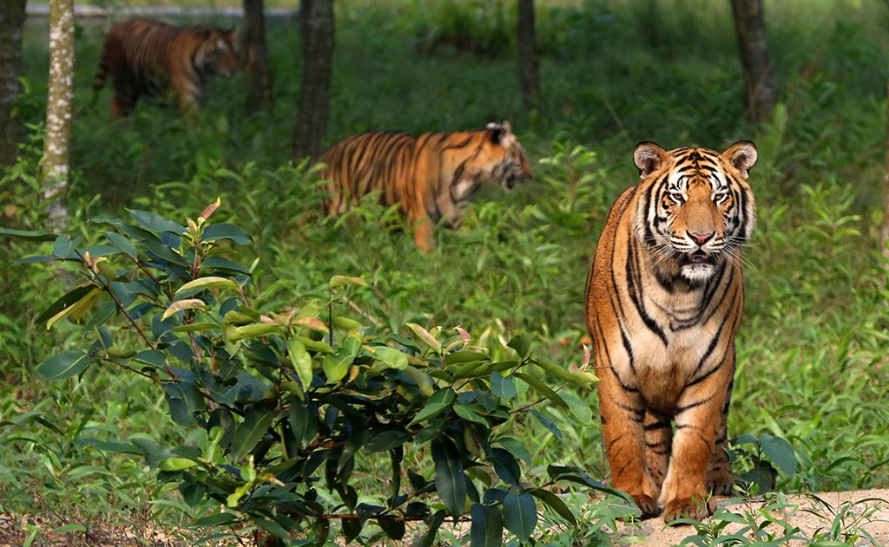

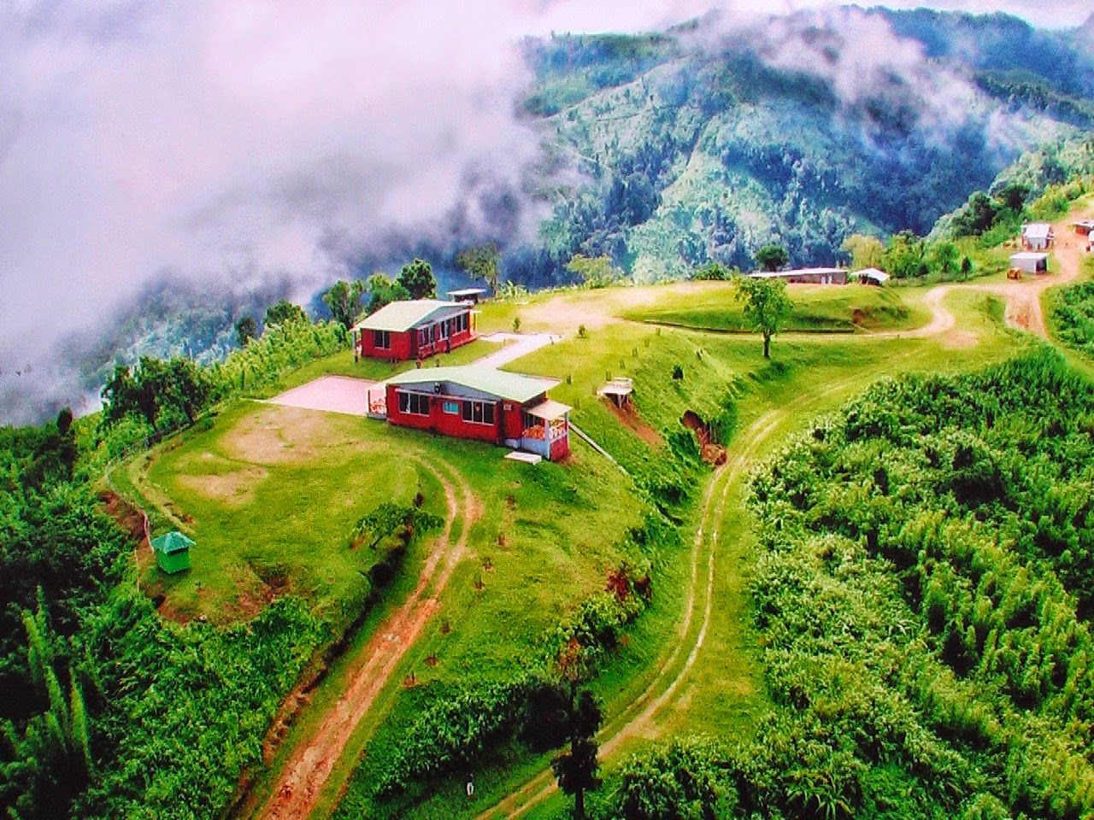
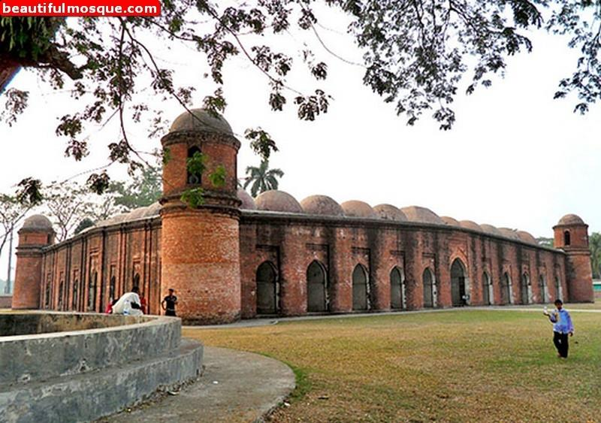
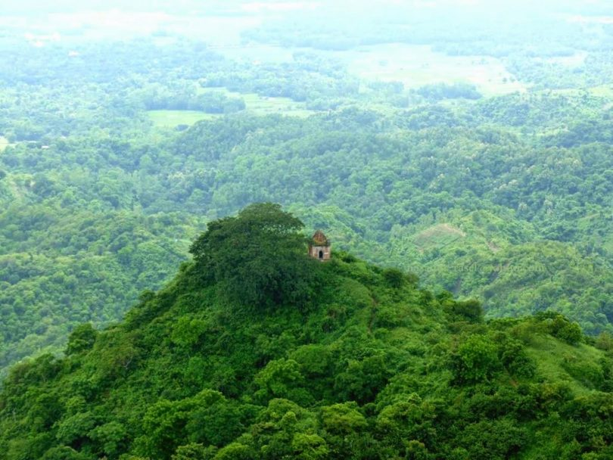
Features
Social Media Link
Displaying Places
Feedback

Slide 6
Feasibilities
Technical Feasibilities
Operational Feasibilities
Economical Feasibilities

Slide 7
Hardware
Laptop & PC
Internet Connection
Technical
Software
Any type web browser
- Google Chrome, Internet Explorer etc.
Operational
Economical
Technology
Up to Date
Secured

Slide 8
User Level
All kinds of people
Technical
User Interface
Operational
Ease to understand
Need to basic knowledge of web browser.
Efficient
Economical
Error Handling and Feedback

Slide 9

Low Budget
Technical Cost
Software Cost
Other Cost
Technical
Operational
Economical

Slide 10




Project Scheduling
Analysis
Design
Development
Testing

Slide 11
Analysis
1 | On-site Meeting | None | 1w
2 | Discussion with Stakeholder | 1 | 1w
3 | Analysis Requirement | 1,2 | 1w

Slide 12
Design
4 | System Design | 3 | 3w
5 | Database Design | 3,4 | 1w
6 | Interface Design | 1,4 | 2w

Slide 13
Development
7 | Develop System Modules | 4 | 1w
8 | Integrate System Modules | 7 | 1w
9 | Perform Initial Testing | 8 | 1w

Slide 14
Testing
10 | Perform System Testing | 9 | 1w
11 | Feedback & Releasing | 10 | 1w

Slide 15
Gantt Chart
ID | Task Name | Start |  | Finish | Duration
 |  |  |  |  |  |  | 08/09 | 15/09 | 22/09 | 29/09 | 06/10 | 13/10 | 20/10 | 27/10 | 04/11 | 11/11 | 18/11
1 | On-site Meeting | 07/09/19 |  | 13/09/19 | 1w
2 | Discussion with Stakeholder | 14/09/19 |  | 20/09/19 | 1w
3 | Analysis Requirement | 21/09/19 |  | 27/09/19 | 1w
4 | System Design | 28/09/19 |  | 18/10/19 | 3w
5 | Database Design | 19/10/19 |  | 25/10/19 | 1w
6 | Interface Design | 19/10/19 |  | 02/11/19 | 2w
7 | Develop System Modules | 19/10/19 |  | 25/10/19 | 1w
8 | Integrate System Modules | 26/10/19 |  | 02/11/19 | 1w
9 | Perform Initial Testing | 03/11/19 |  | 09/11/19 | 1w
10 | Perform System Testing | 10/11/19 |  | 16/11/19 | 1w
11 | Feedback & Releasing |  | 17/11/19 | 23/11/19 | 1w

Slide 16
Risk Analysis
Avoiding travel and security risk.
Handling emergencies and contacting parents.
All participants register for travel insurance.
Database backup.

Slide 17


Pattern of Information Gathering
We have chosen three methods for gathering information --
Interview
Questionnaires
Investigation

Slide 18


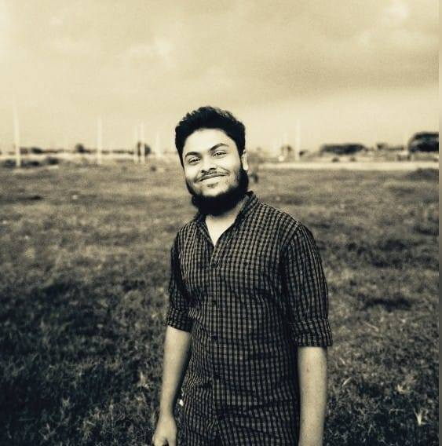

Selection of Interviewee
Interviewee : Team Diplomats
Abdullah Bashar Maruf
Noor Mohammed
Tanveer Rahat
Rahia Rono

Slide 19
Interview Question
1. Why do you need this new service?
Answer : Nearly everyone goes on a vacation. For this, tour and travel management system would play a vital role. I want to provide such a service where a single person can easily added to many other groups. It will save the customers tour cost if they get together and go to their desired destination. The system also helps to develop tourism with different cultures
So that they enrich the tourists experience.
2. What problem is this project going to solve?
Answer : When we make tour we face many kinds of problems such as manage hotel, vehicle, tour guide etc. We want to provide a services that automates the process and perform all operations related to travelling

Slide 20
Interview Question
3. What will happen if this project does not go ahead? How it will affect your business?
Answer : I think it will not affect my business in terms of failure. I want to run this system as my side business. Actually, this is an idea of mine which I want to implement as professionally.
4. What type of works is involved in travel and tourism industry?
Answer : As I told before, All types of travelling operations included medical support, money exchanging.

Slide 21
Interview Question
5. What challenges are you looking for in this service ?
Answer : We can see there are many number of travel agencies in the country, but we want to provide the premium quality services . Our platform would make tourism management easy by handling agencies requests and providing services for the customers located at different parts of the various cities.
6. Why do you want to work with us?
Answer : As we hear from many of friends about your company and your reputation of services. That’s why we have come.

Slide 22
Interview Question
7. What are you hoping will come at this project?
Answer : Actually, the main hope is to contribute in our tourism sector. There are many foreigner who come to see our beloved country. If we provide them a good service they must be give a satisfied rating to our country. Therefore, we want to represent our country to the world people. Also there must be a hope of earning money.
8. Do you have any budget range?
Answer : yes. For the first develop we want spend maximum 50,000 taka.

Slide 23
Interview Question
9. How will you measure the success?
Answer : More signups, more people in our mailing lists, customer feedback etc. all this are variable of measuring the success.
10. What concern you most about this project?
Answer : I love to go on a tour when I get time. I have visited many country with foreign travel agencies . But I have faced many difficulties when I go with local agencies. So, personally I feel concern to improve the quality of our country tourism management.
11. If this project could achieve only one goal, what would it be?
Answer : Of course, the goal is to earn money. As I want to implement this system professionally, my first goal would be money.

Slide 24

Questionnaires
Number of Question : 09
Question Type : Closed Ended

Slide 25
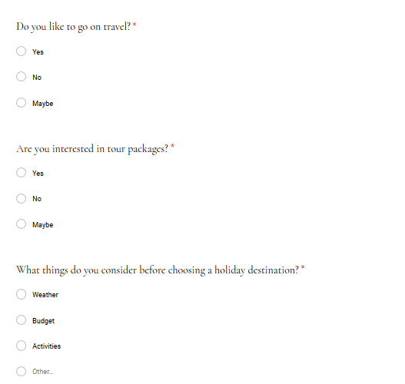
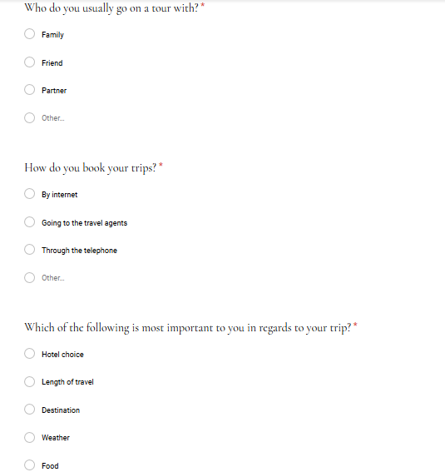
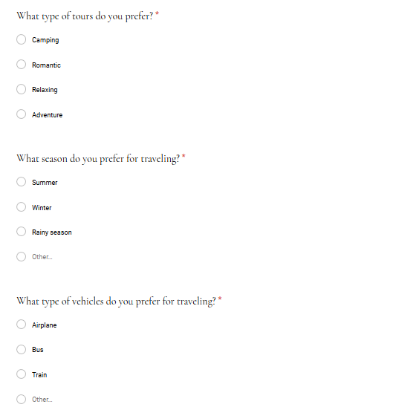
Questionnaires

Slide 26
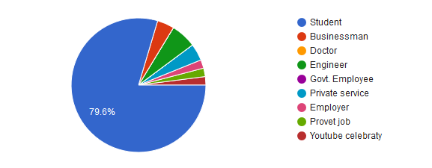
Survey Results
Count of Occupation

Slide 27
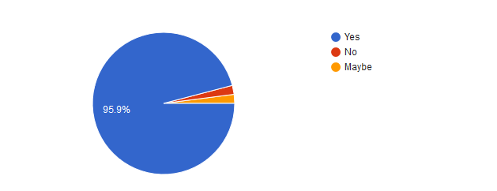
Survey Results(Continued)
Count the people who are interested to go for travelling

Slide 28
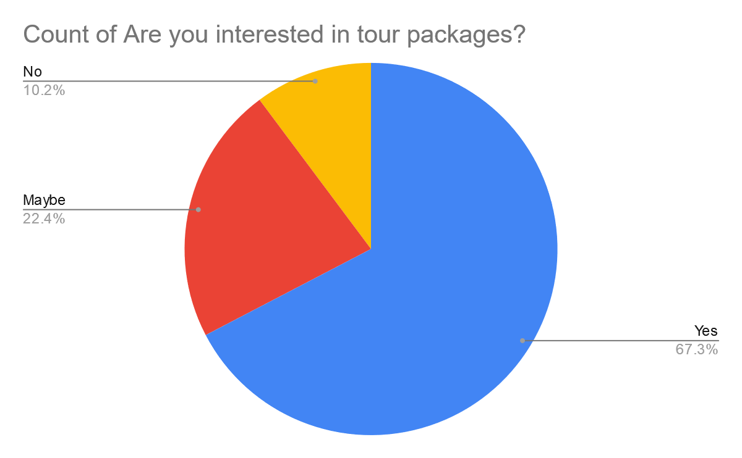
Survey Results(Continued)
Count the people who are interested in tour packages

Slide 29
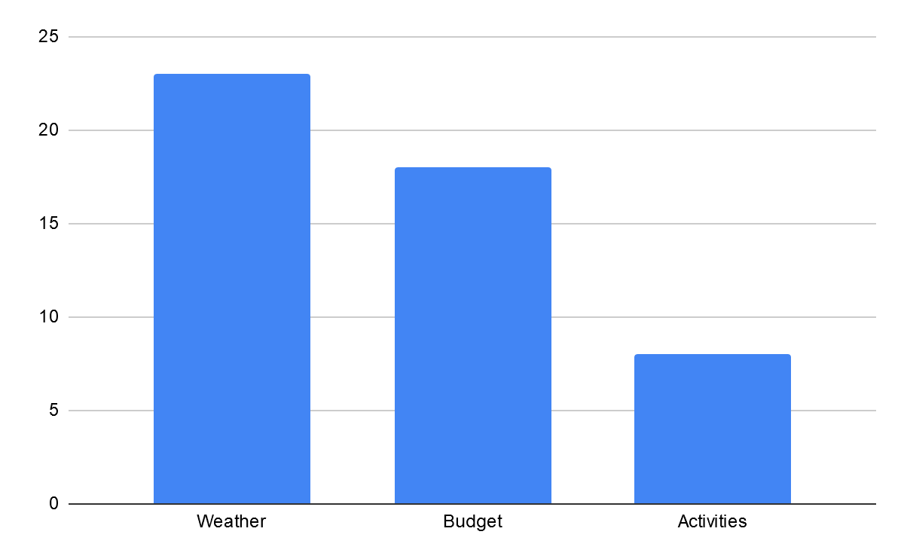
Survey Results(Continued)
Count of consideration before choosing a holiday destination

Slide 30
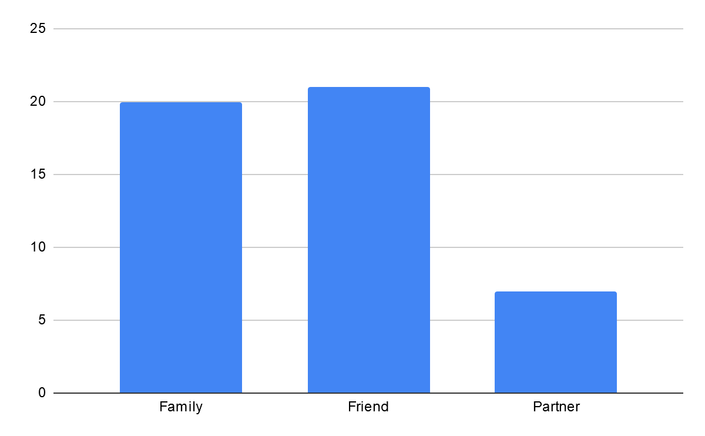
Survey Results(Continued)
Count the users who want to go on a tour with--

Slide 31
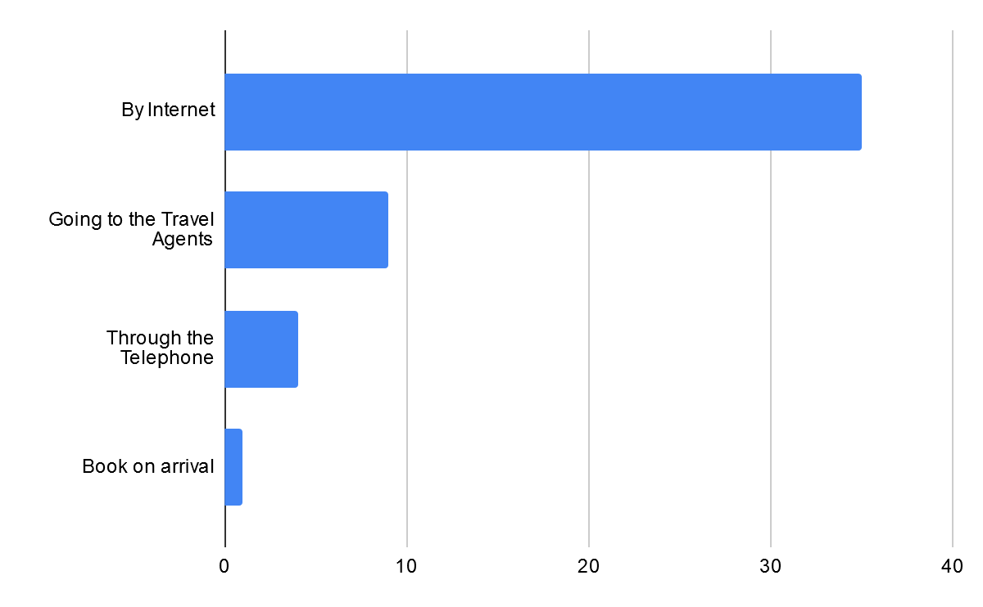
Survey Results(Continued)
Count of the users how they book their trips

Slide 32
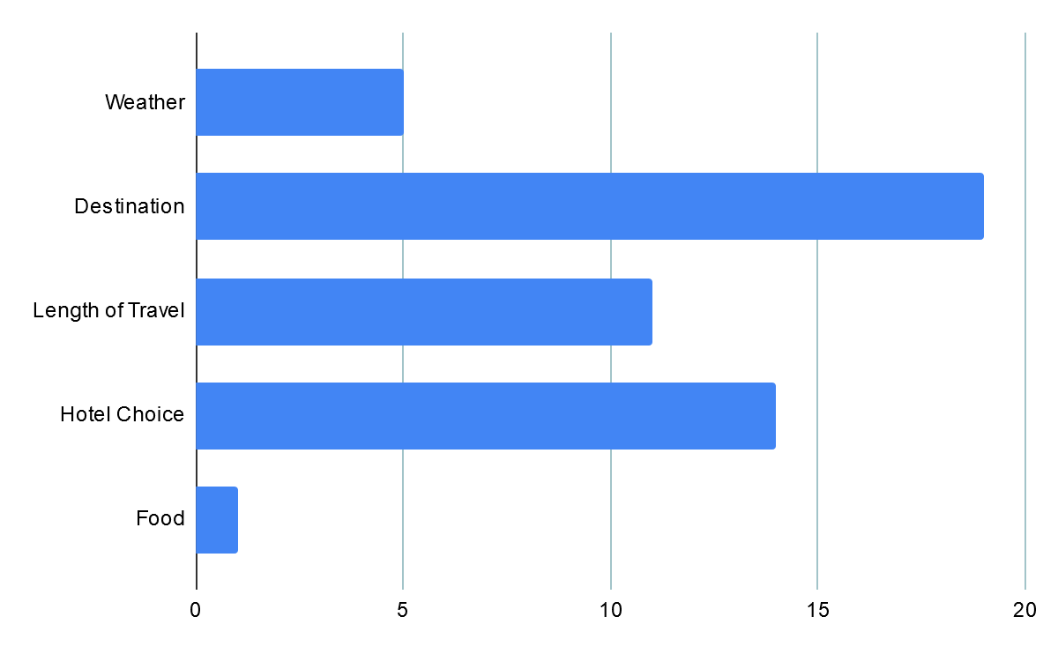
Survey Results(Continued)
Tour Plan Consideration

Slide 33
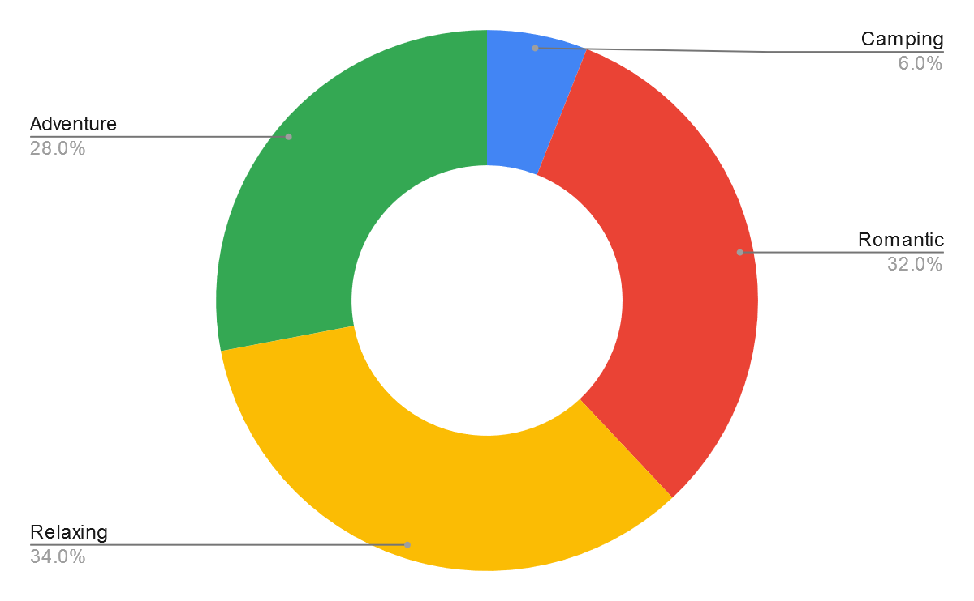
Survey Results(Continued)
Type of Tour Preference

Slide 34
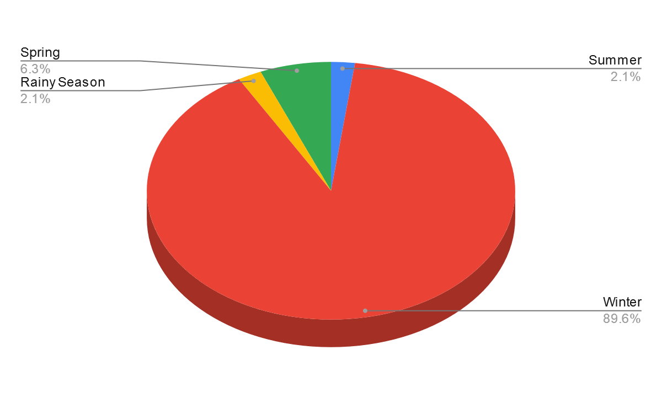
Survey Results(Continued)
Season Preference

Slide 35
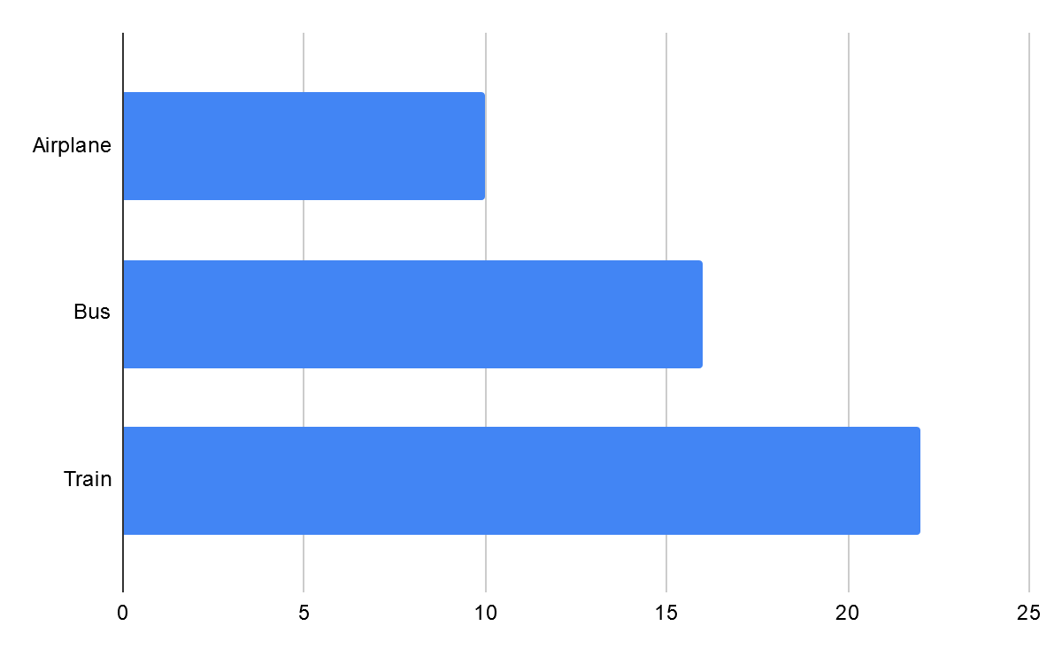
Survey Results(Continued)
Vehicle Preference

Slide 36
Revised Requirement Analysis
Functional Requirement:
Users should be allowed to claim their travelling expenses related to their official visits.
System should support both domestic journey and international journey.
System should capture traveller name or id, destination, time period, purpose and some accounting info as basic data of visit.
There should be tracking the user who entered the travel data.

Slide 37
Revised Requirement Analysis
Non Functional Requirement:
All the UI should be unique and running both IE and Firefox browsers.
Supports many languages.
Reports are exported to different formats.
Evert caption should self explanation.
Valid user/ password.

Slide 38

Topic
Data Flow Diagram(DFD)

Slide 39

Activity List(Package Management)
User can search packages, places, hotels, transports.
User can send booking request and also could find another tourists.
Feedback of the request.
Admin manages all type of package.

Slide 40

Activity List(Administration)
Content modification such as add, delete and modify.
Generating report about tour packages and user who booked the tour packages.

Slide 41
Decomposition of DFD
Context Level | Level-0 | Level-1
Tour and Traveling Management System | 1.0 Package Management | 1.1 Record of Package
 |  | 1.2 Place Management
 |  | 1.3 Hotel Management
 |  | 1.4 Transportation Management
 |  | 1.5 Booking Management
 |  | 1.6 Find Tourist
 | 2.0 Administration | 2.1 Content Process
 |  | 2.2 Work Process

Slide 42
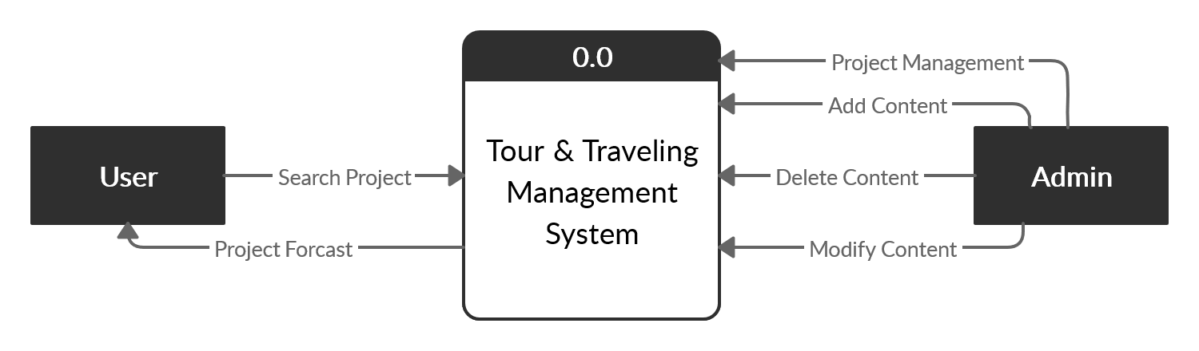
Context Level

Slide 43
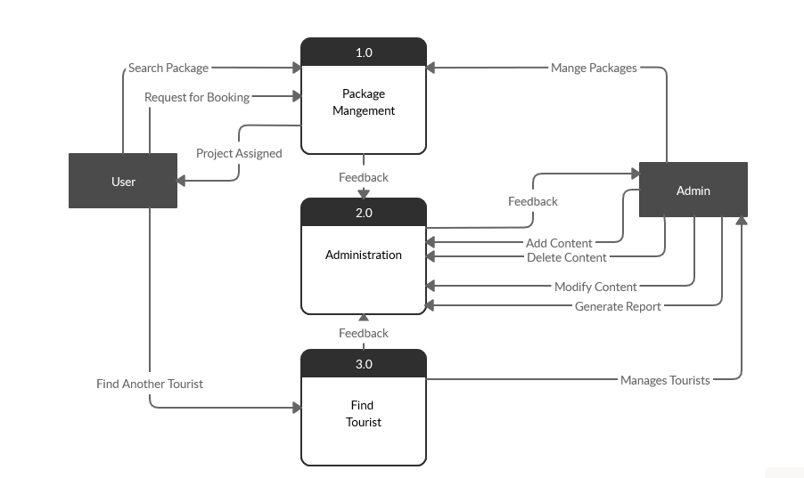
Level-0

Slide 44
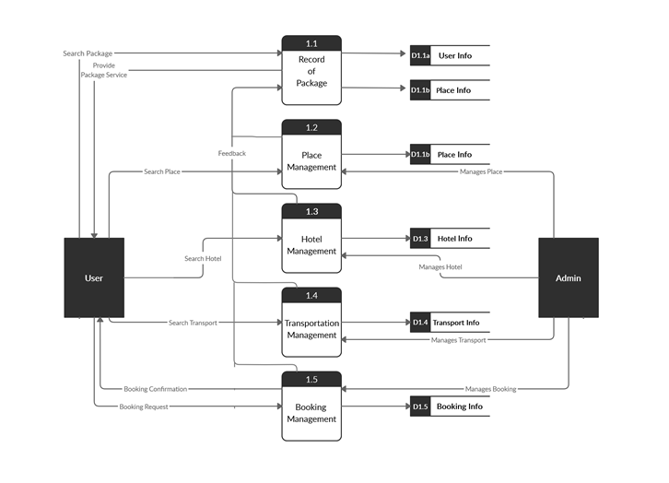
Level-1

Slide 45
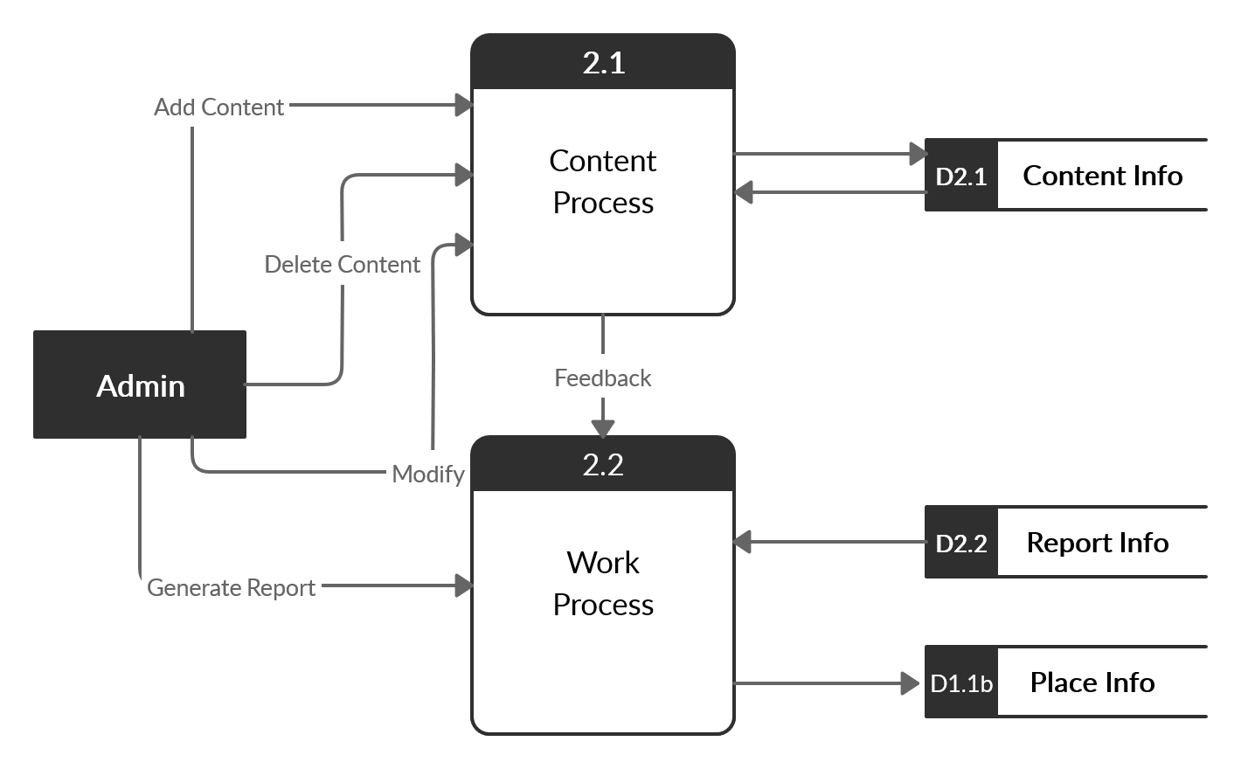
Level-1

Slide 46
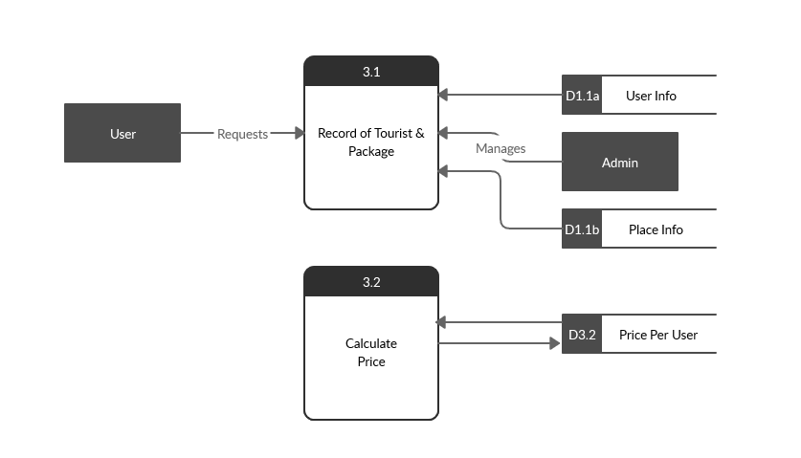
Level-1

Slide 47
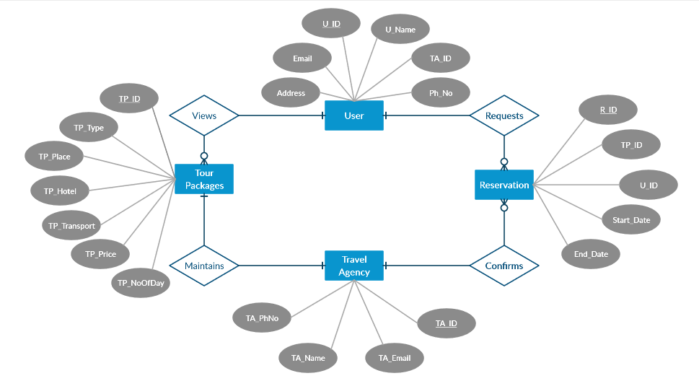
Entity Relationship Diagram

Slide 48

Thank You!!!

